Slide 1
Teacher ROBOT
Rikvender singh & Zaid Khan

Slide 2
Intoduction
The "Teacher Robo" project report provides a comprehensive overview of the development, design, and performance of our educational robot, Teacher Robo. The project aimed to create an interactive robot capable of answering questions from students and delivering educational content. This report details the design, hardware, software, and outcomes of the Teacher Robo project.

Slide 3
PROJECT GOALS
Design and build an educational robot to assist students in their learning.
Implement speech recognition and natural language processing for question-answering.
Develop a chatbot interface powered by ChatGPT for educational content delivery.
Evaluate the performance of Teacher Robo in a simulated classroom environment.

Slide 4
Code Library (ai and car)
wikipediaapi
gTTS
flask import Flask, render_template, request, redirect, url_for
os
speech_recognition
openai

Slide 5
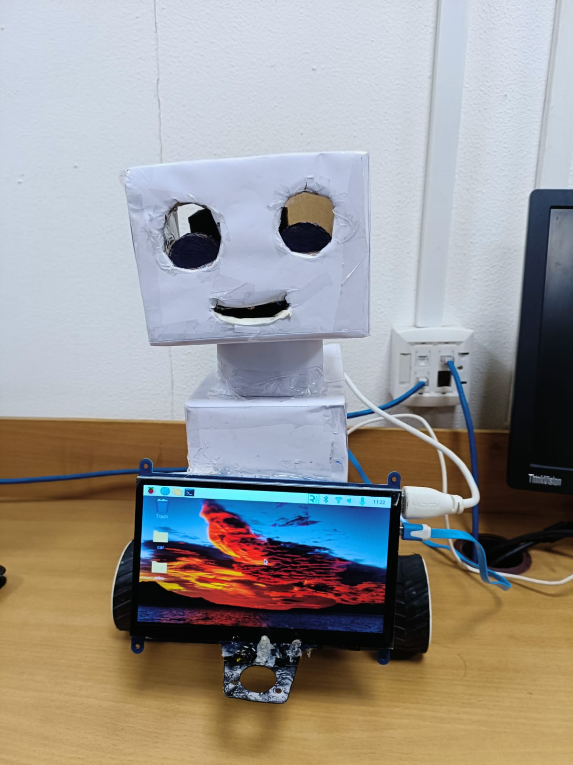
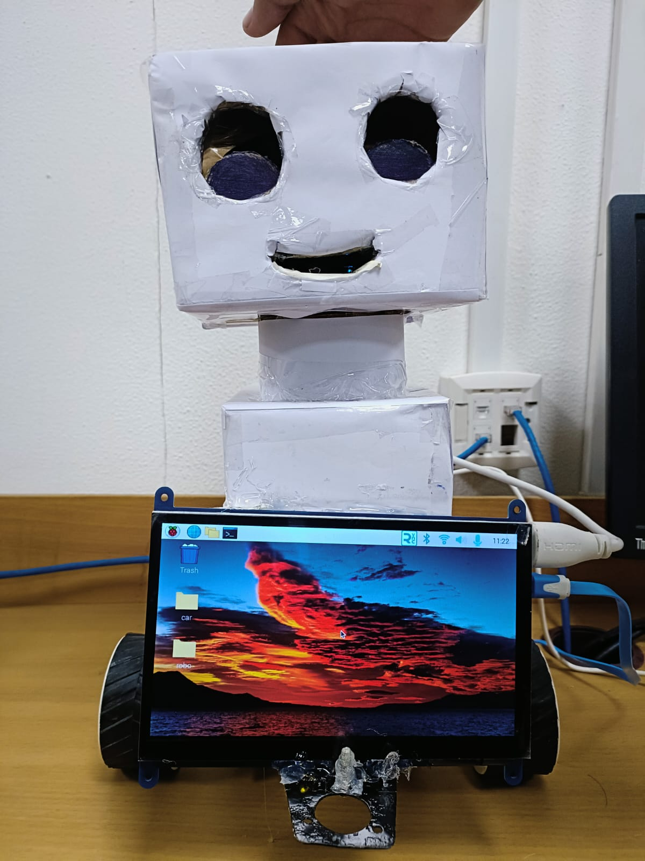
PROJECT STRUCTURE

Slide 6
HARDWARE
Raspberry pi 4: For all script and OS and run the code
Chassis: The robot's physical structure was designed for mobility, stability, and interactivity with students.
Sensors: We integrated microphones and speakers for voice interaction, as well as cameras for vision-based tasks.
Actuators: Wheels and motors allowed Teacher Robo to move within the classroom.
Power System: The robot is powered by rechargeable batteries for extended use.

Slide 7
sOFTWARE
Operating System: The system runs on a custom rasbarrian distribution.
Control System: A Python-based control system manages robot behaviour and interactions.
Wikipedia: Wikipedia use to study a topic .
Speech Recognition: The system employs the Speech Recognition library for voice recognition.
ChatGPT Integration: ChatGPT, powered by the OpenAI GPT-3 API, handles educational content delivery.

Slide 8
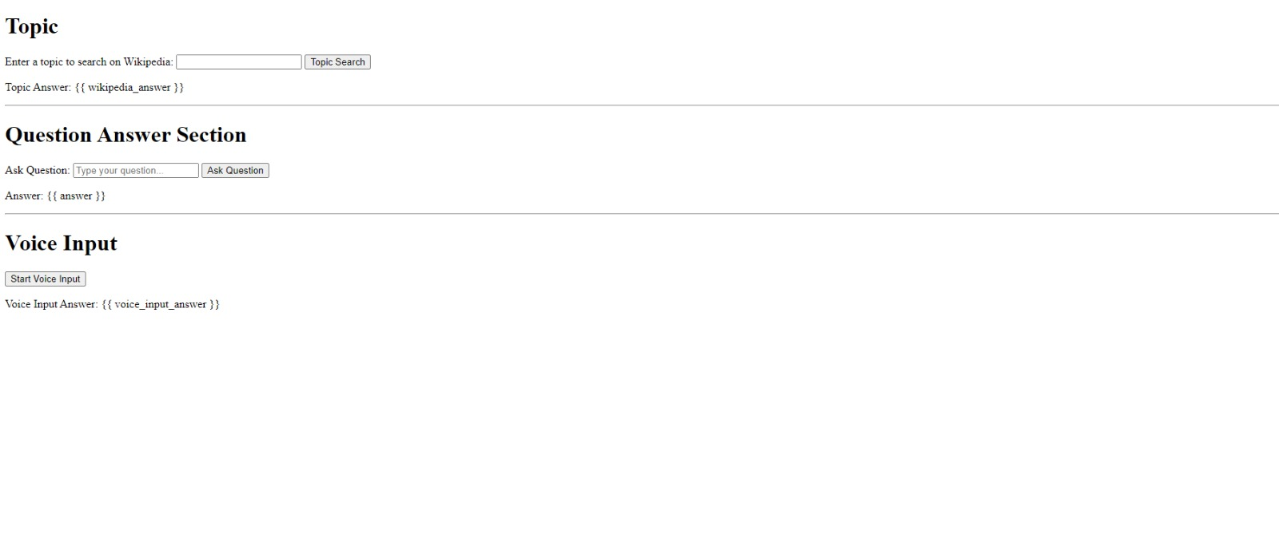
Web interface for teacher

Slide 9
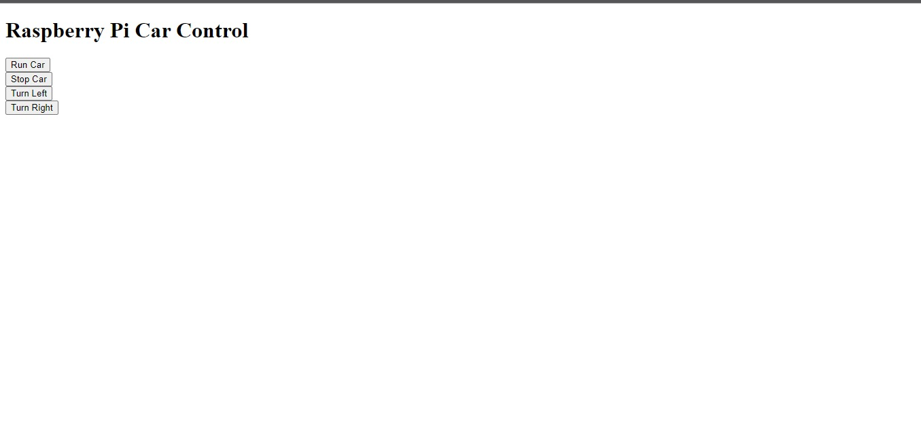
Web interface for car

Slide 10
Conclusion
The Teacher Robo project has achieved its goals of providing an interactive educational tool.
The combination of speech recognition and ChatGPT content delivery offers an innovative approach to educational robotics.
Future enhancements may include more advanced NLP and fine-tuning for specific educational domains.

Slide 11
THANK YOU
From
Rikvender Singh Rajawat
Zaid Khan

